Slide 1
Construction Management
&
Engineering Technology
Dr. Gretchen Dietz (Construction)
Mr. Austin Fifield (Engineering Technology)

Slide 2
Construction Management
Engineering Technology
Industry engagement
Paid internships with course credit
Curriculum crafted for real world application
99% job placement rate
Problem-solvers
Hands-on learning
Industry-standard lab equipment
Highest paid internships
100% job placement rate
Notes:
75 members on IAB that are actively involved in education

Slide 3
Construction Management

Slide 4
Notes:
https://youtu.be/IIt_kon0vtg?si=R_0C_r0ceu3tggY0

Slide 5
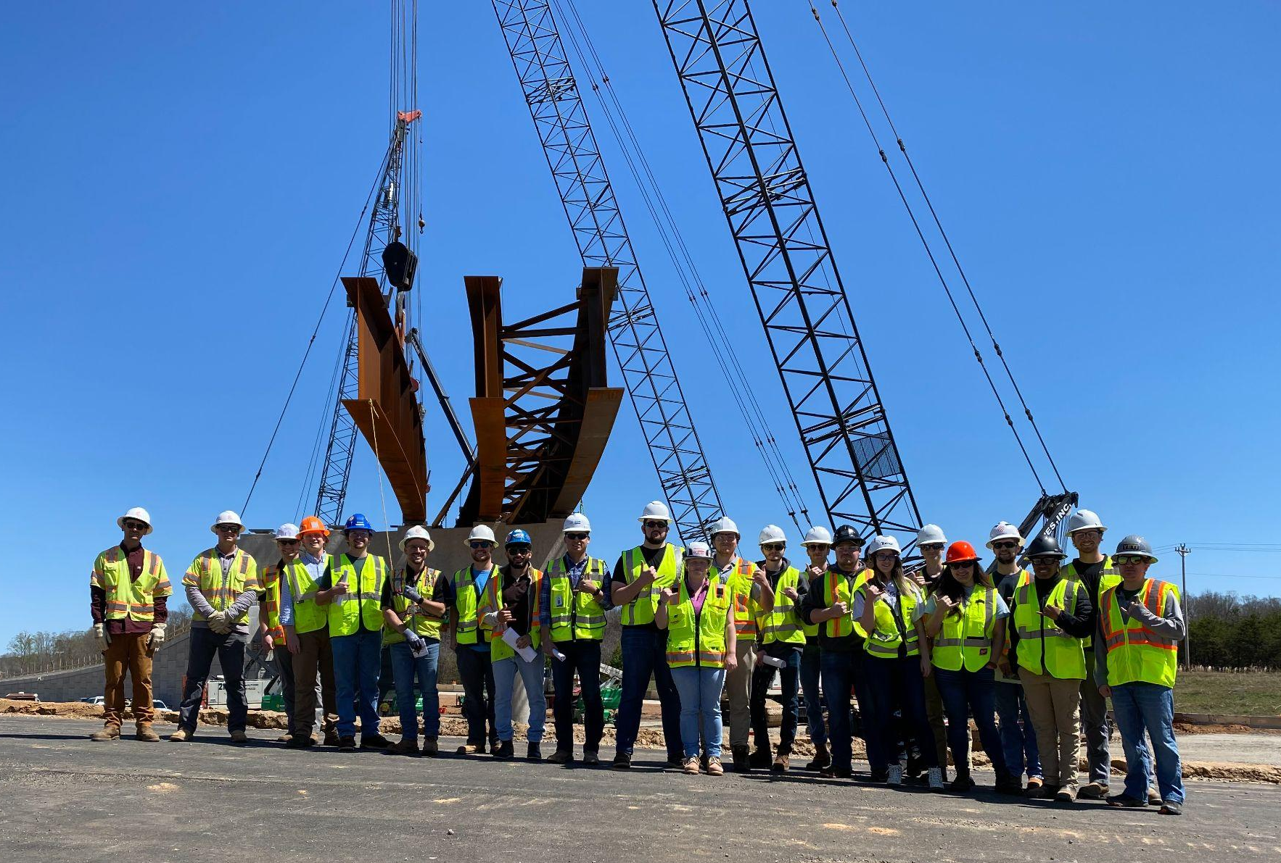
Construction Management
Careers and Expected Salaries
Construction Manager
Project Manager
Cost Estimator
Architectural and Engineering Manager
Designer
Field Engineer
Building Inspector
Scheduler
Internships paying up to $17/hr
Starting salaries $55,000-$80,000
5-year salaries $85,000-$120,000

Slide 6
Engineering Technology

Slide 7
Notes:
https://youtu.be/RiqKw7Gccqc?si=VxzbOjDSsToie4RU

Slide 8
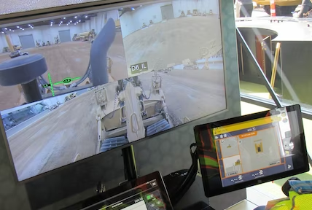
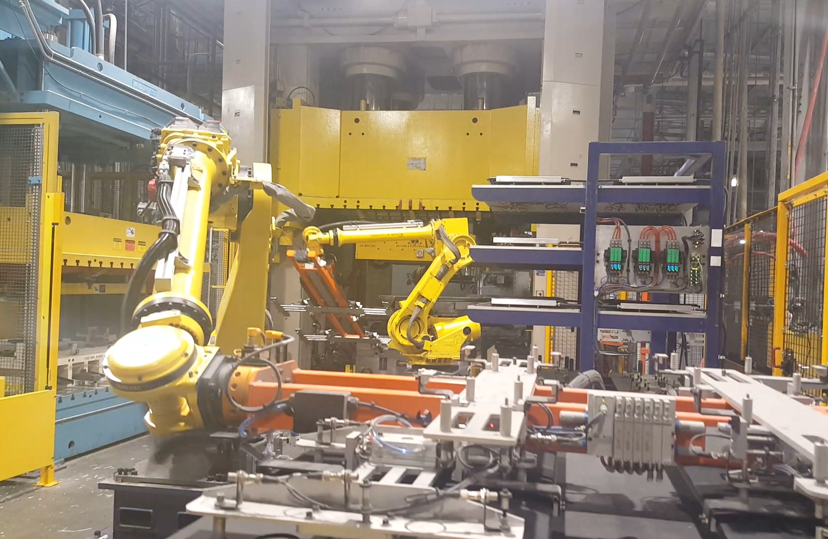
Engineering Technology
Careers and Expected Salaries
Automation Engineer
Controls Engineer
Robotics Engineer
Test and Development Engineer
Electric Power Distribution Engineer
Integration Engineer
Instrumentation Engineer
Product Specialist
Internships paying up to $30/hr
Starting salaries $65,000-$90,000
5-year salaries $80,000-$120,000

Slide 9
Questions

