Slide 1
WELCOME
FUTURE ENGINEERS
Dr. Cathy Blat
Assistant Dean for Student Experiences

Slide 2
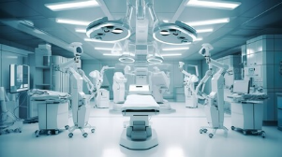
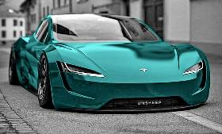
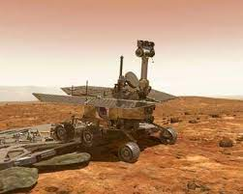
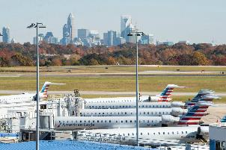
What is Engineering?
Engineering is the application of science and math to solve problems.

Slide 3
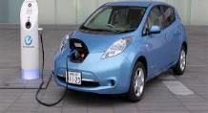
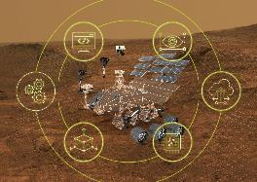
Engineering Majors
Civil
Environmental
Electrical
Computer
Mechanical
Systems & Industrial

Slide 4
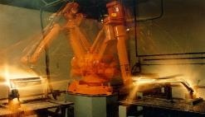
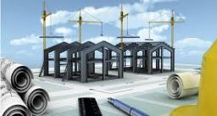
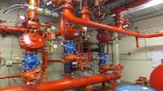
Engineering Technology & Construction Management Majors
Civil Engineering Technology
Electrical Engineering Technology
Fire and Safety Engineering Technology
Mechanical Engineering Technology
Construction Management

Slide 5
COME SEE WHAT AWAITS YOU!
Notes:
Get excited this is what awaits you. This is what our awesome niners are doing.

Slide 6
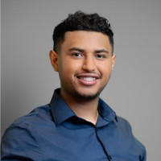
Internship
“I would like to thank Timmons Group for this amazing internship opportunity. One of my favorite things about the Timmons Group internship experience is the endless help I get. Power systems is a very complex subject, and the software that is used to model it is not easy to understand. Looking forward to continue learning and working with everyone.”
Meet Erik
Electrical Engineer
Junior

Slide 7
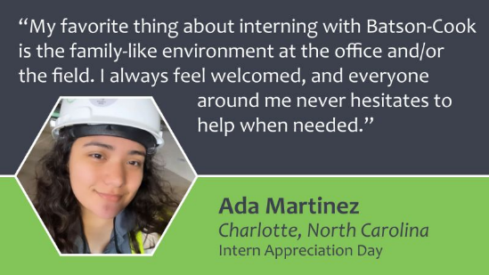
Internship
My desire to build/create new structures brought me to the College of Engineering at UNC Charlotte. While also wanting to have an in-depth business background, I decided to enroll in an Operational & Supply Chain Management Minor at the College of Business.
Meet Ada
Construction Management
Senior

Slide 8
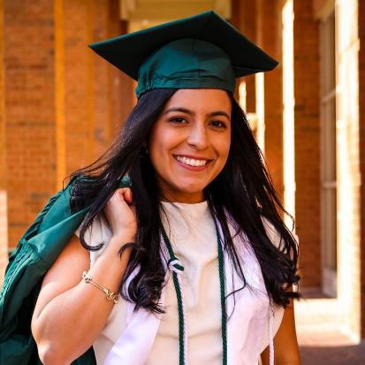
Instrument & Controls Engineer
Natalia came with an Associate Degree in Engineering from CPCC. While at UNC Charlotte she did Internships with General Electric and Siemens.
She received several scholarships including a LAWA Scholarship.
Meet Natalia
Mechanical Engineer
Recent Grad

Slide 9
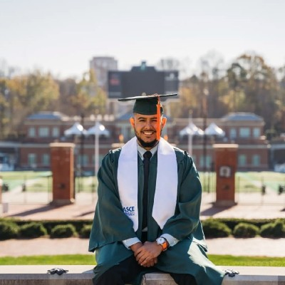
Civil Analyst
“This past December, I earned my Bachelor of Science in Civil Engineering with a Minor in Mathematics from the University of North Carolina at Charlotte. It was not easy, but with a great supporting cast, anything is possible.
Now, it is time to look to the future and continue to grow professionally and expand even further. I am thrilled to announce that I have accepted an offer with Kimley-Horn, where I will be joining the Surface Water team as a Civil Analyst.
Meet Ricardo
Civil Engineer
Recent Grad

Slide 10
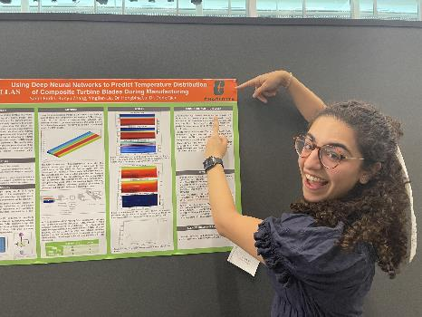
Undergraduate Research Experience
Sarah is a Senior in Mechanical Engineering with a Minor in Chinese and an Energy Concentration. She did an Undergraduate Research Experience in wind energy systems.
“I participated in this program last summer and it was honestly one of my favorite experiences. Students get the opportunity to work on NSF-funded research projects at UT Dallas. They are paid and housing is offered by the program. I learned so much and LOVED this program.”
Add your own image here.
Crop your image to fit
the gray box
Sara
Mechanical Engineering
Notes:
Undergraduate research experience/Because of the number of Math and Physics courses our students take you can earn a minor by just taking one or two extra courses/Leadership Academy/ Jobs on campus

Slide 11
Why Choose
The William States Lee College of Engineering?
Notes:
We just saw the great things our niners are doing but why come to Charlotte?

Slide 12
Learning Environment
Strong Support System
Unmatched Employer Partnerships
Notes:
Here are some reasons

Slide 13
Learning Environment
Small class size
Small college feel within a large campus setting
Students get the best of both worlds
everything available at a major university in a major city
an personalized college experience where you are not just a number
Notes:
Our intro classes are 24- 28 students.
Close to home

Slide 14
Learning Environment
Engineering is a practical discipline, a hands-on profession learning by doing is a key element
Students are able to build essential skills by
Designing
Testing
Building
Unique opportunities for learning
Notes:
Hands on from First Year to Senior Year

Slide 15
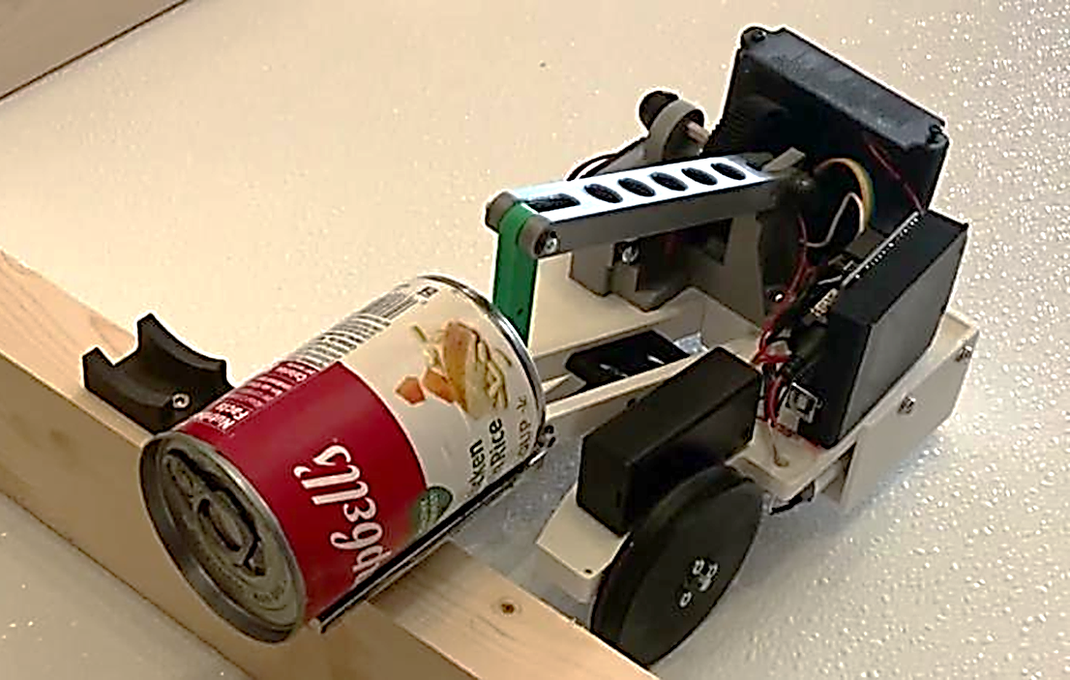
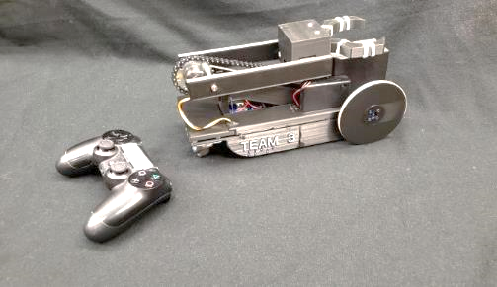
HANDS ON LEARNING
DESIGN PROJECTS
Junior Design
A team of fellow students is tasked to design and manufacture a remote-controlled robot that would be capable of reaching out and grabbing a soup can and safely transporting it over a specified course.

Slide 16
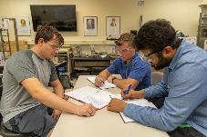
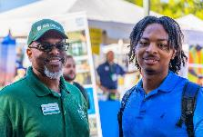
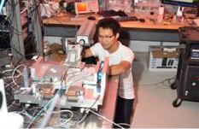
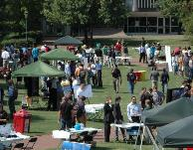
STRONG SUPPORT SYSTEMS
Summer Programs
Academic Advising
Tutoring
Coaching (MAPS)
Learning Community
Engage ME!
WE Engage!
Ambassadors’ Program
Student Organizations
Internships & Co-ops
Leadership Academy
Undergraduate Research
Capstone Project
Academic Support
Engagement
Professional Development
Notes:
We provide you with strong support systems from First year to graduation.
Math review
Bridge program scholarships

Slide 17
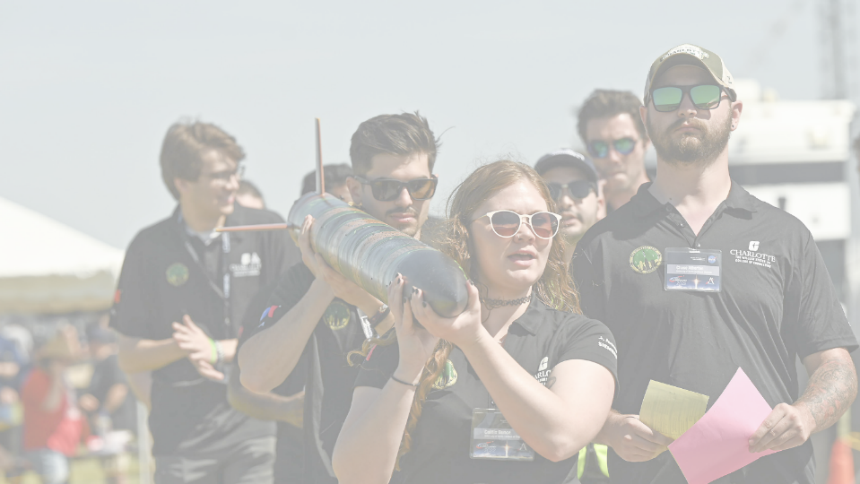
Success is no accident. It is hard work, perseverance, learning, studying, sacrifice, and most of all, love of what you are doing or learning to do.
~Pelé
Notes:
https://www.youtube.com/watch?v=GEtRE_YXHGU
Recently competed. Won for 2 years in a row. Do not have current results.

Slide 18
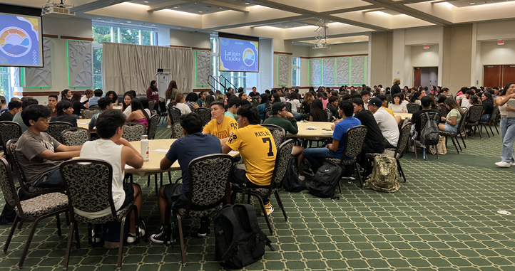
STRONG LATINO COMMUNITY
Notes:
Society of Automotive Engineers just had their first win.

Slide 19
Our Numbers
750
First in the family to attend College
2,900
Students
450
COE
Latino/Latina
Notes:
Here are some of our numbers

Slide 20
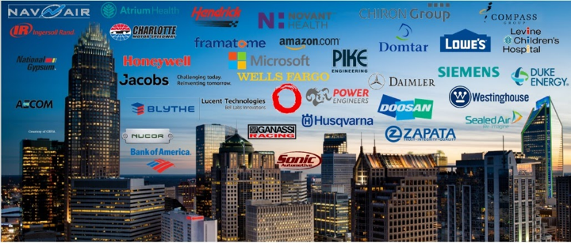
UNMATCHED EMPLOYER PARTNERSHIPS
Corporate Mentoring | Industry Connection Day
Mock Interviews | Alumni Interviews Series
Science Technology Engineering Math (STEM) Job Fairs | Industry Senior Projects
Notes:
Great relationships with employers. Many opportunities to interact with employers.

Slide 21
Our Numbers
83%
Full Time Employment
70%
Experiential Education
17%
Continue to Graduate School
Notes:
Survey Results

Slide 22
Admission Requirements
Engineering Technology & Construction Management
University Admission Requirements
Engineering Majors – Preferred Qualifications
3.8 or higher High School GPA
A grade of C or better in all high school math courses
Completion of Pre-Calculus; Calculus is preferred
A math course in the last year of high school

Slide 23
Questions

Slide 24
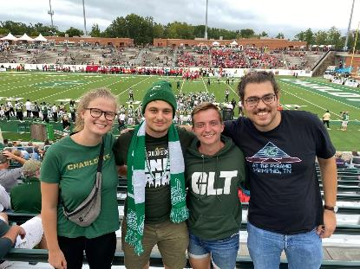
Thank you for joining us!
Please join us for Open House October
Cathy Blat
Cathy.Blat@uncc.edu
@CLTEngineering
clt_engineering
clt_coe_studentlife
Notes:
We hope to see you in the fall. Thanks for coming to our session. Follow us in social media. Announce next steps.

