Slide 1
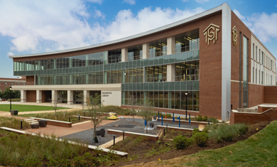
Let’s Talk about College!

Slide 2
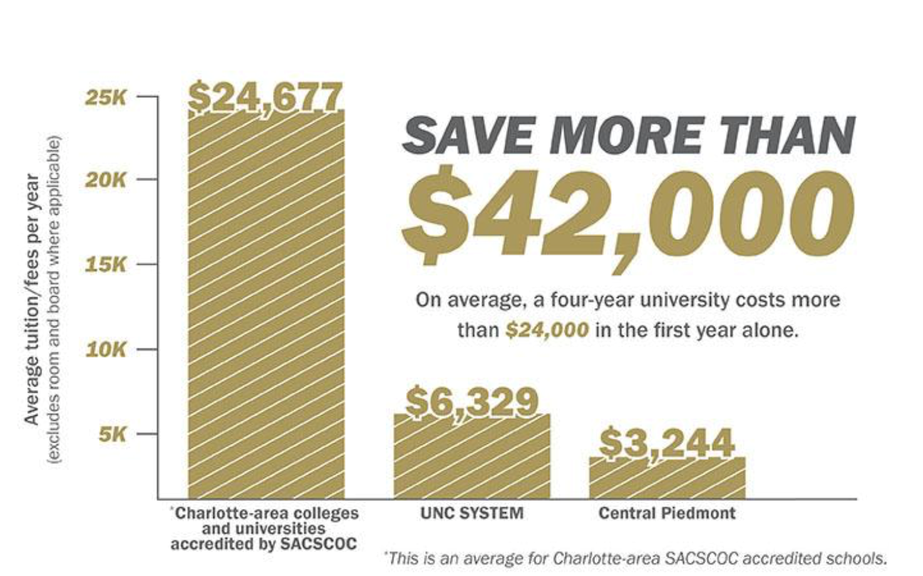
Why should you consider Central Piedmont Community College

Slide 3
Why Central Piedmont ?
Earn an associate degree
Work towards a 4 year degree
Partnership with 4 Year Institutions in North Carolina
Take a direct path to employment
Dual Enrollment
Summer Bridge
49er next
YearUp
Bridge to Careers

Slide 4
Begin the Process!!!!
Enroll Now!
1.Determine your State Residency (RDS)
2. Apply for Admission (if you are a CCP/dual enrollment student, do not reapply to CPCC)
3. Activate your Central Piedmont Login (do not complete this step until you have received your Central Piedmont Student ID through email)
4. Create your CPCC email (create after completing step #3)
5. Line up money for school
6. (Complete Next Steps)
1. Attend Orientation
2. Meet with your Advisor
3. Pay for you classes

Slide 5
Take a guess???
Raffle

Slide 6
Career and College Promise Dual Enrollment
Success in today’s global economy may require a certificate, diploma, or a college degree. Through Career & College Promise (CCP) dual enrollment, qualified high-school-age students in North Carolina can jumpstart their career or college education while still in high school — tuition free.
To learn more about the program, including eligibility requirements and steps to apply, visit our website
https://www.cpcc.edu/dual-enrollment

Slide 7
Summer Bridge Program
Graduating high school seniors, Summer Bridge helps you jump start your college career and get a head start on your college classes the summer after you graduate high school.
With Summer Bridge, you enroll in two college classes at Central Piedmont for six weeks in the summer. This helps you successfully transition from high school to college in a closed, structured, and supervised environment.
Dates June 17–July 26, 2024 Classes held Monday–Thursday, 8 a.m.–1:05 p.m.
Locations Cato, Central, Harper, Levine, and Merancas campuses
The deadline to apply for Summer Bridge is June 3, 2024.

Slide 8
49er Next
l aid workshops and career advising
49er Next is a program for Central Piedmont students who plan to transfer to UNC Charlotte to pursue a bachelor’s degree.
Our unique program promotes your student success by offering collaborative advising that helps you progress toward timely degree completion, coordinated financial aid workshops and career advising.
49er Next is a guaranteed admission to UNC Charlotte after successful completion of their associate’s degree.

Slide 9
Year Up
Year Up enables young adults, ages 18-29, to
move from minimum wage to meaningful
careers in just one year.
At Year Up, we’re working to connect
talented and motivated young adults like you
to career opportunities at top companies.
We want to equip you with the skills,
experience, and support you need to
launch a professional career.

Slide 10
Bridge To Careers
Minority based Scholarship
Certificate programs or 2-year degree programs
Advanced Manufacturing, Construction, Healthcare, Information Technology, and Transportation

Slide 11
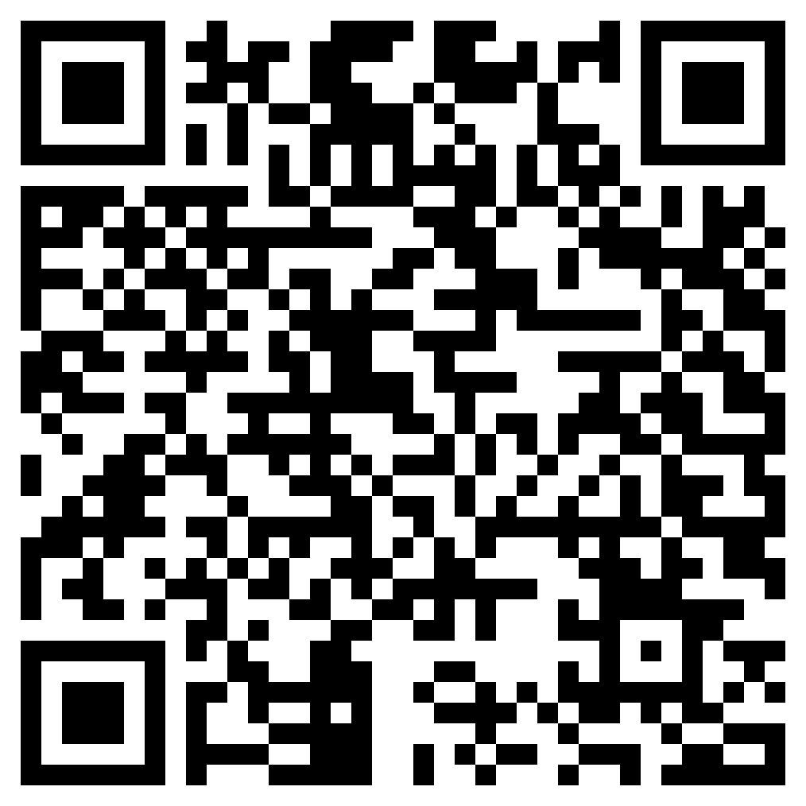
Interest QR Code

Slide 12
Questions????

