Slide 1
You and Your Money
Wells Fargo Kristi Thomas
August 8, 2020
© 2020 Wells Fargo Bank, N.A. All rights reserved. For Internal use.
Notes:
[PERSONAL INTRODUCTION]
Good morning! Thank you for talking time on a Saturday morning and for giving me the opportunity to speak with you today. My name is Kristi Thomas and I’m with Wells Fargo. Today, we are going to discuss some basics tools for smart money management. I know how important it is as a college student to closely watch your spending and your budget. I just sent my own son back to college in Chicago this week and he is still learning how to manage money living in a big, expensive city.
I’ll go through this presentation and then leave a few minutes for questions at the end. Let’s get started!
[click]

Slide 2
Budget Basics
Notes:
[click]

Slide 3
Discussion
What are the benefits of a having a written plan for your money?
What does it mean to make trade- offs?
What is something you never seem to have enough money to buy?
Notes:
Presenter Notes:
Who has a written plan for managing their money today?
Anybody use a budget or an app to track their spending?
How many of you have a job or will be working while you’re attending school?
How many of you save money on a regular basis today?
Great – thanks for that input!
[click]

Slide 4
What is the purpose of a spending plan?
Spending plans help you to:
Reach your goals
Stay focused
Show where you need additional help
Notes:
Presenter Comments/Notes:
So what’s the purpose of a spending plan or a budget?
The goal is simple – it is to spend less than you earn—and to save what is left for big-ticket items like travel or new college books, and for emergencies like an unexpected car expense.
• Spending plans help create good and sustainable habits.
• In order to reach your goals, it helps to know where you need to focus and where you might need additional help.
[click]

Slide 5
Creating a spending plan
Spending plans help you to:
Track your spending.
Itemize your income and expenses.
Total and compare the income and expense columns to create your spending plan.
1
2
3
Notes:
Presenter Comments/Notes:
Creating a spending plan starts with tracking your spending. Then, you have to itemize what cash is coming in, what cash is going out and what cash is left over at the end of the month. If you do this well, you should be able to answer the question: “Where is my money going?”
Let’s go through each of these three steps, one at a time.

Slide 6
Creating a spending plan
Track your spending
Keep a spending diary for 1-2 months and record everything you spend as well as how you spend it (cash, check, credit, debit, ATM, etc.)
Maintain all receipts, credit card statements and check registers.
1
Notes:
Presenter Comments/Notes:
First, you need to know how much you are spending, and where.
• A simple way to do this is to keep a spending diary for a month or two to see how much money you spend on a daily and monthly basis. Track your spending for several weeks. Record every dollar you spend and how you spend it, whether by cash, check, debit card, ATM card, or credit card.
• Also – try to keep all your receipts, sales slips, monthly statements and your checkbook register—you’ll need them for the next step to actually create your budget.
.

Slide 7
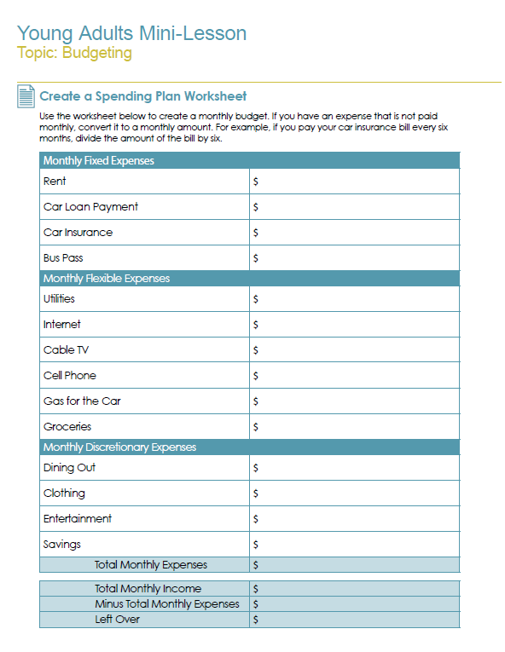
Spending Plan Worksheet
7
Notes:
Presenter Comments/Notes:
Print and distribute copies of the worksheet shown above. You can find the worksheet on slide 30 of this presentation.
In step 2, we’re going to itemize your income and expenses using the Spending Plan Worksheet,
I asked Ana to get a copy of this sheet to you so you can use it after this session. Or you can just create something like it, or find an app that works for you.
You can create an excel spreadsheet or use notes on your phone too.

Slide 8
Creating a spending plan
Itemize your income and expenses
List and total your monthly income from all sources.
List and total your monthly expenses and put each expense in one of the categories.
2
Notes:
Presenter Comments/Notes:
The Spending Plan Worksheet will help give you an accurate account of where you're spending your money. Let’s walk through it together.
After you’ve kept track of your spending next is to
First part of any budget is to itemize/break down your income and expenses---It is important to track what your expenses are.
What are your Fixed Expenses?-Those expenses that occur regularly and do not really change from month to month such as the rent or car payment.
What are your Flexible Expenses? –Expenses that are necessities. You buy these regularly but have more control over how much you spend, e.g. groceries or gas. Let’s use an example of why you have more control over these expenses. How about gas? What could you do differently one month to save money on gas? (Carpool, ride the bus).
Finally, What are your Discretionary Expenses?--Dollars you choose to spend, but don’t necessarily have to spend on things like clothes, movies, and going out to eat
At the bottom, after you’ve entered all of the different types of expense, you will enter your total monthly income. The money you are earning from a job or other places.

Slide 9
Creating a spending plan
Total and compare your income and expenses to create your spending plan
If you have money left over, you have a positive cash flow.
If you spend more than your income, your cash flow is negative.
3
Notes:
Presenter Comments/Notes:
Step 3 -Once you’ve itemized and subtotaled all your income and expenses, you can determine your net cash flow, which is your total monthly income less your total monthly expenses. Hopefully, you have money left over at the bottom.
• If you have money left over, you have a positive cash flow. If so, you're in good shape—you're spending less than you're earning. Maybe you’ll want to budget the extra money to pay any debts or to put that money into savings.
• If your expenses exceed your income, you have a negative cash flow. One way to deal with this is to reduce your "variable" expenses—the expenses that aren't fixed every month. Like your gas or eating out.

Slide 10
Spending plan tips
Keep it simple—don’t get too detailed with your spending plan
Set aside money each pay period to cover large expenses that are not monthly (insurance bills, car repairs, holiday gifts, etc.)
Before you make a purchase ask yourself:
Do I really need it?
What would happen if I didn’t buy it right now?
Can I meet this need less expensively?
Limit your installment debts (car loans, credit card bills, other loans) to 10-20% of your monthly spending plan
Review your bank and credit card statements to monitor where your money is going
Notes:
Presenter Comments/Notes:
Here are a few tips that may help you as you put together your spending plan.
First, try to keep your plan as simple as possible, so it’s easy to remember and work with.
Make sure the plan takes into account large expenses that are outside of your normal monthly bills.
When you’re about to make a purchase, get in the habit of asking yourself these three questions so you can make an informed decision. [READ QUESTIONS IF DESIRED]
Try to limit any loan payments to no more than 10-20% of your monthly spending.
And finally, carefully review all your financial statements each month. You can check with your bank to see if they offer online banking which makes it really easy to keep track of your money.
SOURCE
http://www.handsonbanking.com/library/en/Budget%20Tips.pdf

Slide 11
Monthly spending plan review
Review your spending plan monthly and ask yourself:
Am I over or under my spending target?
Are my variable expenses in line?
What are my “budget busters?”
Are any expenses out of control?
Will I make my planned surplus by year’s end?
Notes:
Presenter Comments/Notes:
Finally, once you’ve created your plan you will want to continue to use it.
Each month, review your spending plan and ask yourself these questions to see where you stand. [READ QUESTIONS IF DESIRED]
Good idea to review on a monthly basis.
Let me stop for a minute to see if you have any questions before we move on to other tips and tools?
PAUSE

Slide 12
Money saving tips
1
Obtain buy-in from family
Focus on the number of dollars you need to save per day
Look at lower-cost alternatives
Shop around for the best interest rate
Pay yourself first
Take advantage of your company’s payroll deductions
If possible Save bonus income
8
Save coupon money
Collect loose change
Review cell phone costs
Save lunch money
Save money from sales
Have a “Buy Nothing” week
2
9
10
3
11
12
4
13
5
6
7
Notes:
Okay – let’s wrap up with some tips on saving.
There are many ways to stretch your dollar and make it go farther. Here are a few that have worked for many of our customers. You can read through them and pick the ones that you think will work for you! Let’s highlight a few from this list.
• Number 2: Focus on number of dollars per day to save. Dividing the total amount of your purchases into a “daily savings amount” will give you an idea of what actions you could take daily or weekly or monthly to realize one or more of the financial goals you’ve set.
• Number 8: If you find clip coupons online or find other ways to save, take the money you save and put it away.
• Number 10: Review your cell phone statement to get a handle on your monthly costs and how to reduce them. Call customer service at your cell phone company to ask for help in understanding the lingo and how it affects you: peak calling periods, area coverage, roaming and especially termination charges. Make sure your calling plan matches the pattern of calls you typically make.
• Number 13: Have any of you ever had a “Buy Nothing” week? Try it for 7 days! You can even involve family members and make it into a fun competition!

Slide 13
10 leading causes of overspending
1
The “latest and greatest” syndrome
Using credit instead of cash
Eating out
Borrowing from the future
Keeping up with the Joneses
Impulse buying
Money “burning a hole in your pocket”
Not knowing how much you have to spend
9
Rationalizing spending = “I need it because...”
Not knowing what you are spending your money on
2
10
3
4
5
6
7
8
Notes:
There are many reasons why we may, at times, have a tendency to overspend. Do any of these look familiar?
The most important step in avoiding overspending is to make a commitment to yourself. It might be helpful for you to have some specific financial goals that you are working towards. If you commit to yourself and write down your goals, you will be less likely to spend in the moment and more willing to hold out for your financial goals.
Let’s talk about a few of the ways people often overspend, for example:
• Number 3: Eating out burns up a lot of money. If this is true for you, try bringing your lunch to work a certain number of days a week (start small if you need to with just one day a week). Or eat out one less time a month. Order water instead of soft drinks, and split an entrée or share a dessert.
• Number 6: If you have a tendency to buy things on impulse – especially online - try waiting for at least 24 hours before buying anything over a certain dollar amount. You’ll have fewer regrets and more savings.
• Numbers 8 & 10: Not knowing how much you have to spend—and what you’re spending your money on. Many of us don’t have a clear understanding of what cash is coming in, what cash is going out and what is left over.

Slide 14
Basics – right starting point
Manage your accounts
Checking, saving, credit card and debit card
Keep track of all your “spending”
If you don’t have it – don’t spend it!!
Use account options to save you money and time
Mobile and online banking
Account alerts
Direct deposit
Notes:
Presenter Comments/Notes:
The easiest plan to begin managing your money is one with your basic accounts --- checking, savings, and debit/credit cards. A checking account is for your everyday expenses. Many people use a debit card for their everyday expenses like groceries or gas. A savings account is used to help you set aside money for your short-term or long-term goals.
You have several options to track your spending……for instance how many of you have a cell phone?
You can check with your bank to see if they offer mobile banking – then you can always check your account online and even set-up alerts when your balance hits a certain level.
By tracking your accounts, you can potentially avoid overdrafts which can save you money.
Finally – one Key concept in managing you money --- don’t spend money you don’t have.
[click]

Slide 15
Questions?
Kristi Thomas
Kristi.Thomas@wellsfargo.com

